Slide 1


The Medicine Delivery Robot
Brock Stechschulte (stechsbj@mail.uc.edu), Anthony Dietz (dietzan@mail.uc.edu), and Kevin Blount (blountkn@mail.uc.edu)
Project Advisor – Janet Dong (dongjg@ucmail.uc.edu)

Slide 2
Abstract
For our project we are tackling the problem of how hard it is for senior citizens receive their medications in their own home. To resolve this problem we are creating The Medicine Delivery Robot. This robot will deliver a person’s medicine to them wherever they are in their home. As a team we have all witnessed senior citizens have a tough time remembering to take their medicine, or to be physically unable to retrieve their medicine. As engineers, it would be fulfilling to build and program a robot that would navigate your home and deliver important medications to the person in need.

Slide 3
Project Purpose/Goal Statements
Deliver medicine to elderly people or people with mobility problems
Locate the person in need of the medications
At certain scheduled times, deliver the required medications
Return to starting locations

Slide 4
User Stories
As a person in need of assistance, I want a robot that can deliver me medicine so that I don't miss taking my medications.
As a person in need of assistance, I want to be able to set medicine delivery times so that I get my medications when I need them.
As a person in need of assistance, I want to be able to press a button to bring the robot to me so that I can take life saving medications in the case of an emergency.
As a person in need of assistance, I want a web application so that I can configure medicine delivery and call the robot when needed.

Slide 5
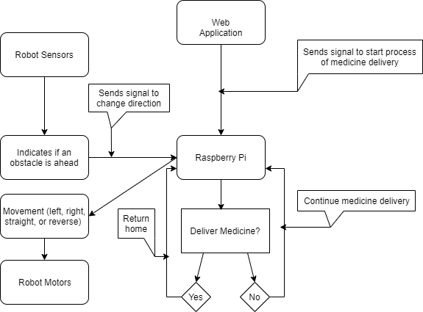
Design Diagrams

Slide 6
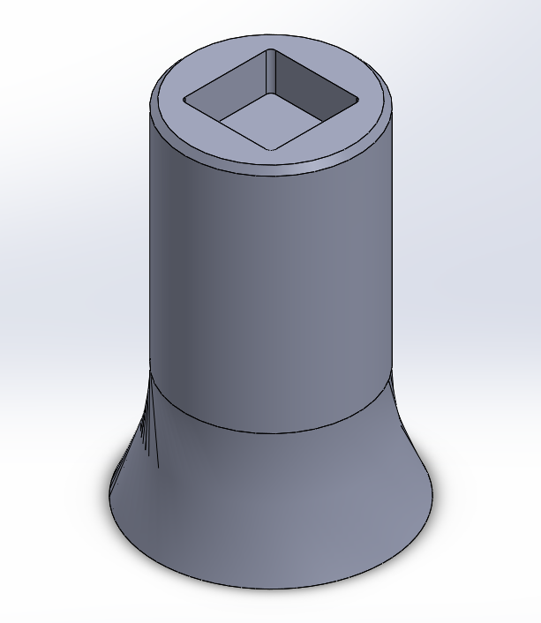
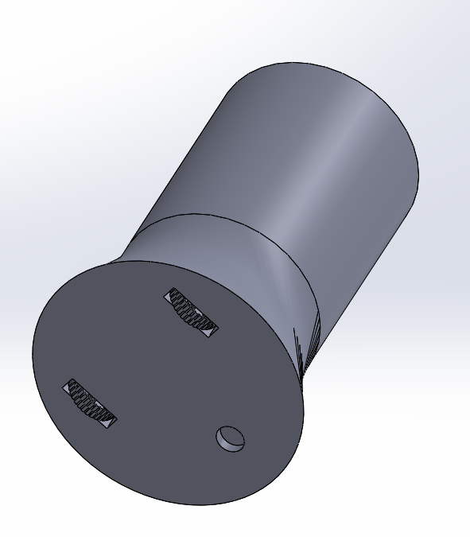
Design Diagrams

Slide 7
Project Constraints
Security
Outside user attempts to control robot
Economic
Automated robots like Roomba can be over $1,000.00
Environmental
The environment that the medicine delivery robot can function in is limited

Slide 8
Current State of Project
Web application and database running
Robot design complete

Slide 9

Expected Accomplishments
3D Print Robot
Web Application

Slide 10
Project Timeline, Milestones, Division of Work
Task ID | Start | Finish | Primary | Kevin’s Effort | Anthony’s Effort | Brock’s Effort | Progress
1 | 09/15/19 | 10/12/19 | Kevin | 90% | 10% | 0% | 100%
2 | 09/15/19 | 10/02/19 | Anthony | 50% | 50% | 0% | 100%
3 | 09/28/19 | 10/08/19 | Anthony | 60% | 40% | 0% | 100%
4 | 10/15/19 | 11/01/19 | Anthony | 70% | 30% | 0% | 75%
5 | 10/16/19 | 10/21/19 | Kevin | 40% | 40% | 20% | 0%
6 | 11/01/19 | 12/01/19 | Anthony | 75% | 25% | 0% | 0%
7 | 11/01/19 | 12/01/19 | Brock | 0% | 0% | 100% | 0%
8 | 12/01/19 | 12/30/19 | Brock | 0% | 0% | 100% | 0%
9 | 01/09/20 | 02/01/20 | Brock | 0% | 0% | 100% | 0%
10 | 01/15/20 | 02/12/20 | Kevin | 90% | 10% | 0% | 0%
11 | 01/16/20 | 02/01/20 | Anthony | 0% | 100% | 0% | 0%
12 | 02/13/20 | 03/01/20 | Kevin | 80% | 20% | 0% | 0%
13 | 03/01/20 | 03/23/20 | Brock | 0% | 0% | 100% | 0%
14 | 03/04/20 | 03/15/20 | Kevin | 50% | 40% | 10% | 0%
15 | 03/20/20 | 03/24/20 | Anthony | 20% | 80% | 0% | 0%
16 | 03/20/20 | 04/01/20 | Brock | 0% | 0% | 100% | 0%
17 | 04/01/20 | 04/08/20 | Brock | 33% | 33% | 34% | 0%
18 | 04/09/20 | 04/09/20 | All | 33% | 33% | 33% | 0%
Research sensors to incorporate on robot (Kevin)
Research robot design (Anthony)
Investigate possible design concepts (Anthony)
Finalize design concept (Anthony)
[Milestone 1] Obtain robot parts to begin working on drive (Kevin)
[Milestone 2] Finalized CAD design for drive train (Anthony)
Research development design of robot (Brock)
[Milestone 3] Complete web application (Brock)
Develop code for robot's drive train (Brock)
Design storage compartment (Kevin)
[Milestone 4] Complete Robot Movement (Anthony)
[Milestone 5] Complete work on storage compartment (Kevin)
Develop code to open/close storage compartment (Brock)
Implement sensors and camera (Kevin)
Validate development is complete (Anthony)
[Milestone 6] Validate robot functionality is complete (Brock)
Refine and test robot (Brock)
[Milestone 7] Tech Expo Presentation (All)

Slide 11
Expected Demo at Expo
User navigate the web application to request the robot’s assistance.
Robot is able to deliver the medicine to the user.
Robot then returns to the starting location.

Slide 12
Questions?

